Slide 1





Using Python Libraries from Delphi
Muhammad Azizul Hakim
Embarcadero
Python Technical Blog Writer
learndelphi.org/boot-camp-2022

Slide 2
Who is this Session for?
Delphi Developer who want to add powerful Python libraries into their program
Python Developer who want to easily create Desktop or custom apps, outside the common Tkinter GUI, Jupyter, or Streamlit ecosystem
Programmer/Tech Enthusiast who wants to witness the magic of combining 2 programming language giants

Slide 3

Goal of this Session
Attract Python developers to use P4D to create GUIs and learn more about Delphi.
Add Python Data Science library powers for Delphi developers.
Inspire the open-source community to develop more advanced use cases using P4D.

Slide 4
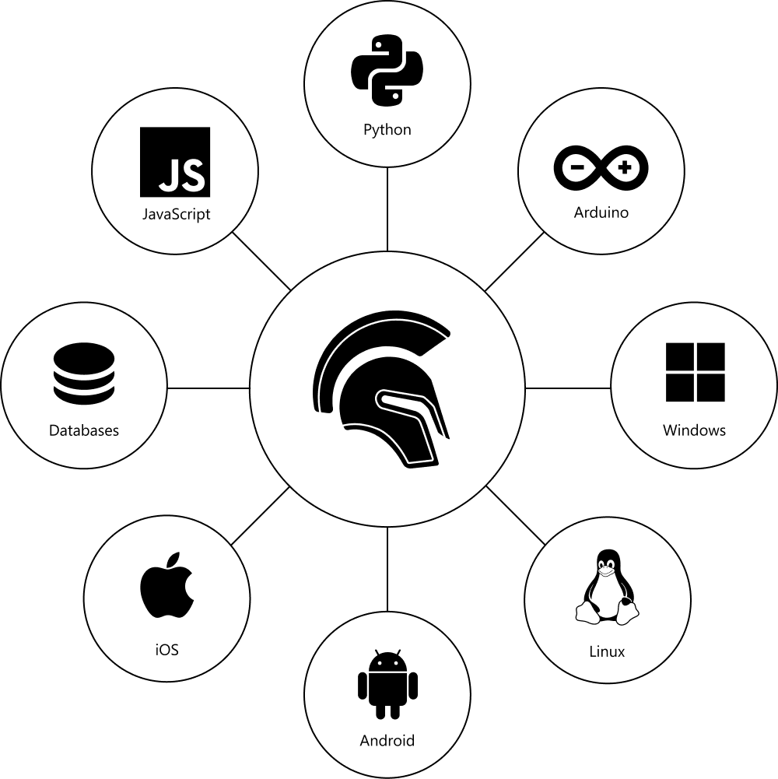
Agenda
Philosophy of Delphi and Python
Introduction to Python4Delphi
Prerequisites
Code & Demo 01: Scrapy4D
Code & Demo 02: Matplotlib4D, Fastai4D, ScikitLearn4D, and NetworkX4D
Code & Demo 03: Pandas4D
Further Readings

Slide 5
Delphi’s DNA
Developer productivity – The main goal is getting things done quickly
Maintainability – Code is easy to read and understand with good encapsulation
Fast compiled native apps – Compiles fast, and native applications run fast
Database access – Always includes a rich set of database access components
Platform API access – You don’t need to call platform APIs, but can if you want
Property-Method-Event – General model for working with components
Visual designers – WYSIWYG with drag and drop interface
Reliable applications – Exception handling and component owner model
Backwards compatibility – Even with all the updates most code is compatible
Rich component ecosystem – There is usually a component for everything

Slide 6
The Zen of Python
1. Beautiful is better than ugly.
2. Explicit is better than implicit.
3. Simple is better than complex.
4. Complex is better than complicated.
5. Flat is better than nested.
6. Sparse is better than dense.
7. Readability counts.
8. Special cases aren't special enough to break the rules.
9. Although practicality beats purity.
10. Errors should never pass silently.
11. Unless explicitly silenced.
12. In the face of ambiguity, refuse the temptation to guess.
13. There should be one-- and preferably only one --obvious way to do it.
14. Although that way may not be obvious at first unless you're Dutch.
15. Now is better than never.
16. Although never is often better than *right* now.
17. If the implementation is hard to explain, it's a bad idea.
18. If the implementation is easy to explain, it may be a good idea.
19. Namespaces are one honking great idea -- let's do more of those!

Slide 7

What is Python4Delphi
Set of components that wrap up the Python DLL into Delphi and Lazarus (FPC).
Delphi developers:
Execute Python scripts,
Create new Python modules and new Python types.
Python developers:
Delphi’s award-winning VCL functionalities for Windows
Modern GUI with Windows 10 looks and responsive controls for Python applications.

Slide 8
Prerequisites
Beginner to intermediate knowledge in programming (especially in Delphi & Python) would help you a lot
RAD Studio installed https://www.embarcadero.com/products/rad-studio/start-for-free
Python installed
Python4Delphi installed https://www.youtube.com/watch?v=hjY6lBgrHhM
Installation of the following Python libraries:
Scrapy, Matplotlib, Fastai, scikit-learn, NetworkX, and Pandas

Slide 9


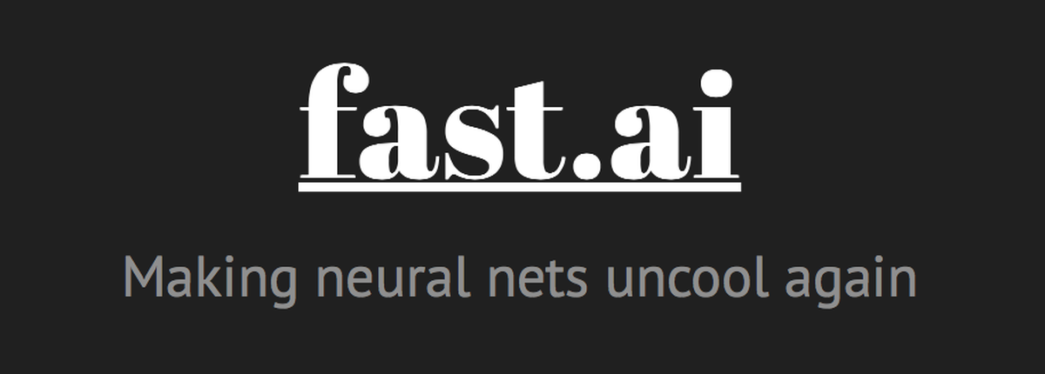


Prerequisites – Python Libraries
Recommended practice - Using Anaconda distribution:
conda install -c conda-forge scrapy
conda install -c conda-forge matplotlib
conda install -c fastai -c pytorch -c anaconda -c conda-forge fastai gh anaconda
conda install -c anaconda scikit-learn
conda install -c anaconda networkx

Slide 10
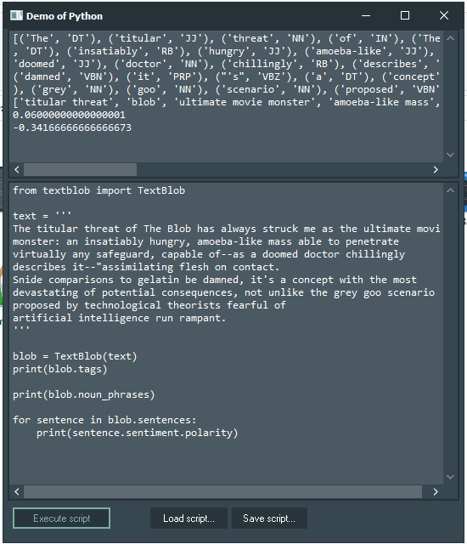
Main Idea
To extend the existing Python4Delphi Demos
Browse the existing demo here: https://github.com/pyscripter/python4delphi/tree/master/Demos (shown right: Example of Demo 01)
What I’ve achieved in this first iteration:
All Python code is hidden/set up at the back-end.
Image and table output are shown inside the GUI.
Interchangeable between Python version & distributions (regular Python vs Anaconda distributions) to avoid complicated conflicts for some Python libs.

Slide 11

Demo 01: Scrapy4D

Slide 12
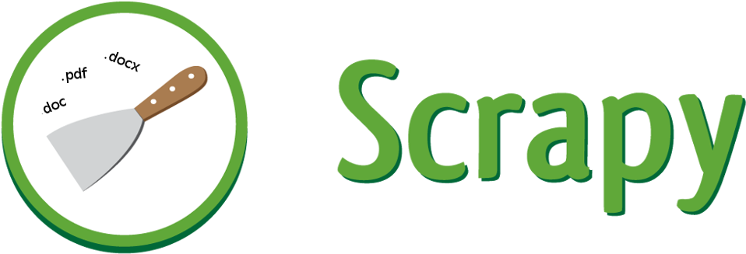
Demo
What is Scrapy?
Scrapy is a fast high-level web crawling and web scraping framework
used to crawl websites and extract structured data from their pages.
It can be used for a wide range of purposes: From data mining to monitoring and automated testing.

Slide 13
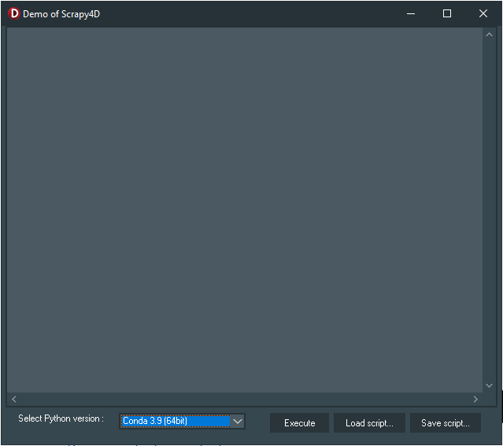
Demo
List of components used in the Scrapy4D demo app:
1. TPythonEngine
2. TPythonModule
3. TPythonType
4. TPythonVersions
5. TPythonGUIInputOutput
6. TMemo
7. TOpenDialog
8. TSaveDialog
9. TSplitter
10. TPanel
11. TLabel
12. TComboBox
13. TButton

Slide 14
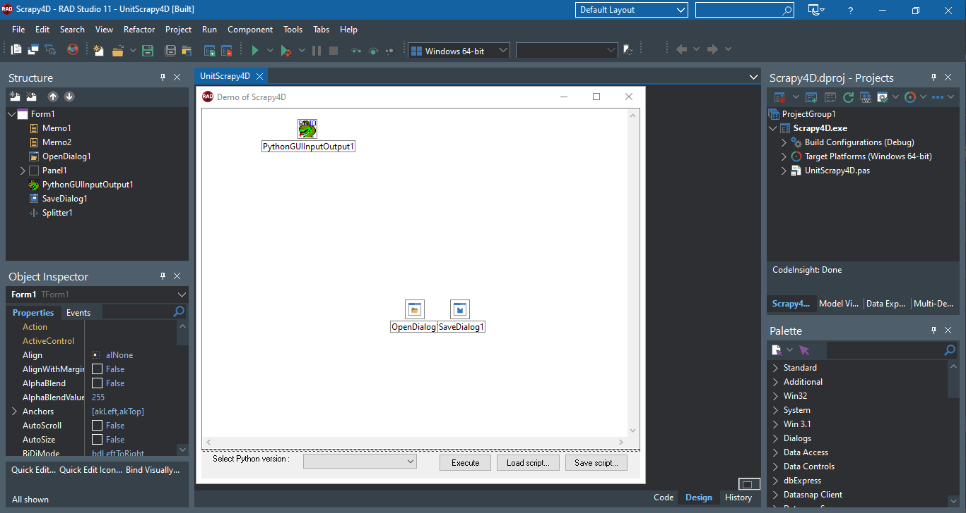
Demo

Slide 15
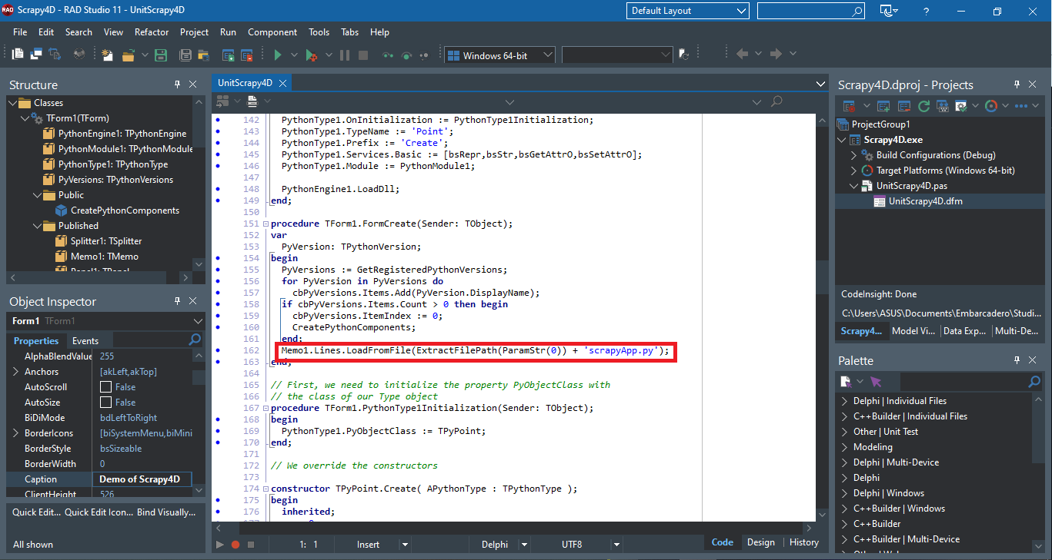
Demo

Slide 16
Demo
Set up these paths to your Environment Variable, for Anaconda Python:
C:/Users/YOUR_USERNAME/Anaconda3/Lib/site-packages
C:/Users/YOUR_USERNAME/Anaconda3/Lib/site-packages/scrapy
C:/Users/YOUR_USERNAME/Anaconda3/Library
C:/Users/YOUR_USERNAME/Anaconda3/Library/bin
C:/Users/YOUR_USERNAME/Anaconda3/Library/mingw-w64/bin
C:/Users/YOUR_USERNAME/Anaconda3/pkgs
C:/Users/YOUR_USERNAME/Anaconda3/Scripts

Slide 17
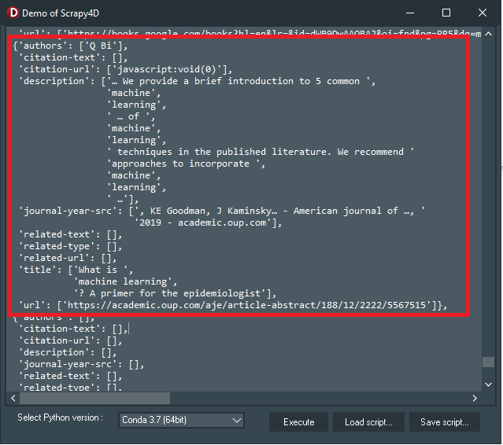
Demo
What Scrapy4D Demo do?
Import the scrapy library and run the basic example, by executing the “scrapyApp.py” on the backend
Scraping quotes from quotes.toscrape.com
Scraping titles and URLs from multiple Wikipedia pages at once
Scraping all Google Scholar search results, for “machine learning” query search
Read more: https://blogs.embarcadero.com/what-is-the-best-web-scraping-library-for-development-on-windows/

Slide 18
Demo
What Next?
Save the output to JSON, instead of only printing it on TMemo
For some scenario, we want to save the output into CSV instead of JSON
And show the output in TStringGrid, instead of Tmemo
Add NLP capabilities to the GUI
Your suggestions!

Slide 19
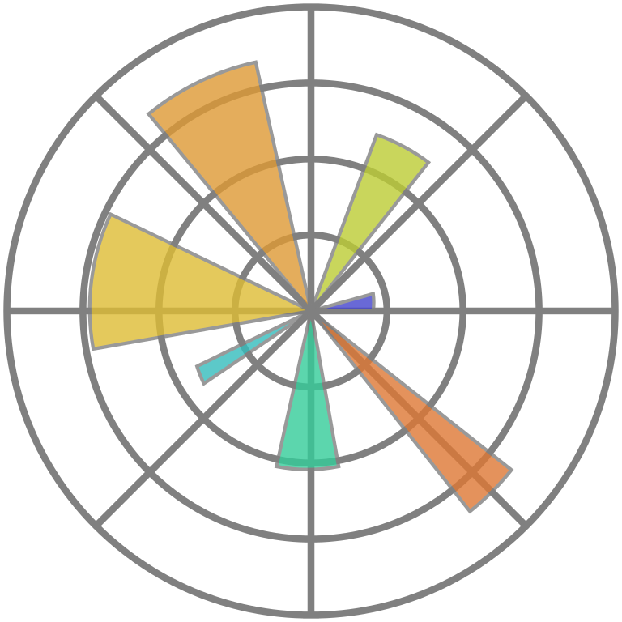

Demo 02: Matplotlib4D,
Fastai4D,
ScikitLearn4D,
NetworkX4D

Slide 20
Demo
What is Matplotlib?
Matplotlib is a comprehensive Python library for creating
static,
animated, and
interactive visualizations.
Matplotlib produces publication-quality figures in a variety of formats and interactive environments across platforms.

Slide 21
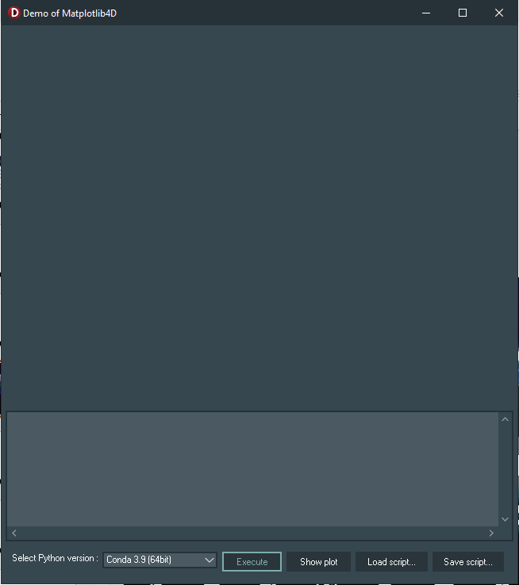
Demo
List of components used in the Matplotlib4D demo app:
*the following component are also used in the Fastai, scikit-learn, and NetworkX demo
1. TPythonEngine
2. TPythonModule
3. TPythonType
4. TPythonVersions
5. TPythonGUIInputOutput
6. TForm
7. TMemo
8. TOpenDialog
9. TSaveDialog
10. TSplitter
11. TImage
12. TPanel
13. TLabel
14. TComboBox
15. TButton

Slide 22
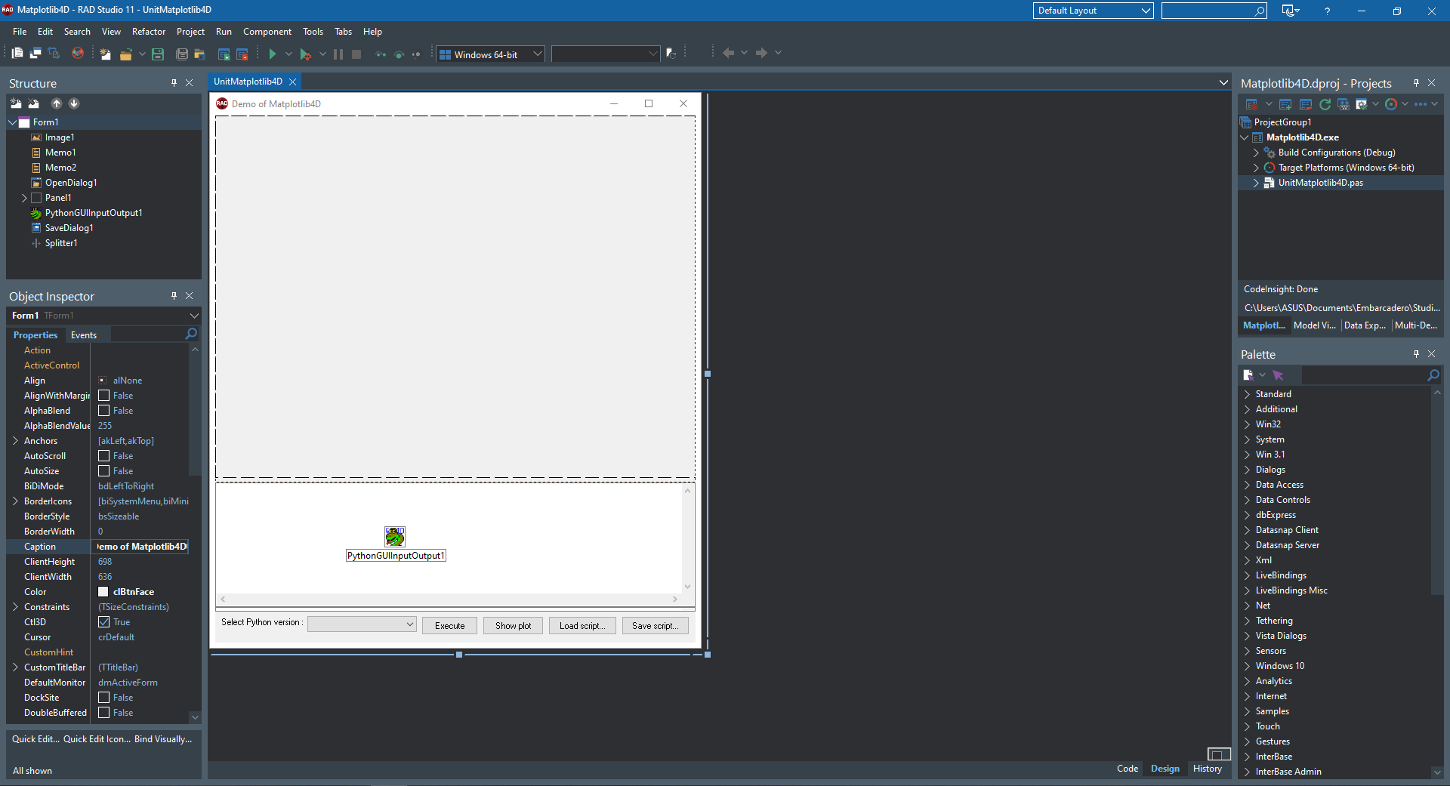
Demo

Slide 23
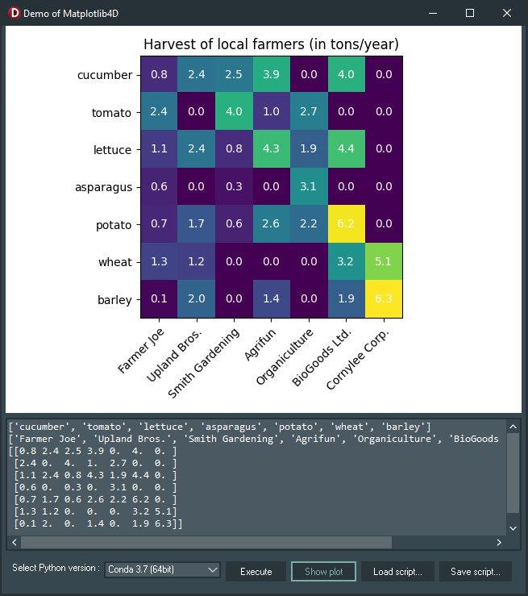
Demo
What Matplotlib4D Demo do?
Import the matplotlib library and run the basic example, by executing the “matplotlibApp.py” on the backend
Plotting Annotated Heatmap
Plotting Anatomy of a Figure/Plot
Read more: https://blogs.embarcadero.com/how-to-make-powerful-data-visualizations-with-matplotlib/

Slide 24
Demo
What is fastai?
fastai is a deep learning library that built on top of PyTorch, one of the leading modern and flexible deep learning frameworks.
It has a goal to make the training of deep neural networks as easy as possible, and, at the same time, make it fast and accurate using modern best practices.
It provides practitioners with high-level components that can quickly and easily provide state-of-the-art results
and provides researchers with low-level components that can be mixed and matched to build new approaches.

Slide 25
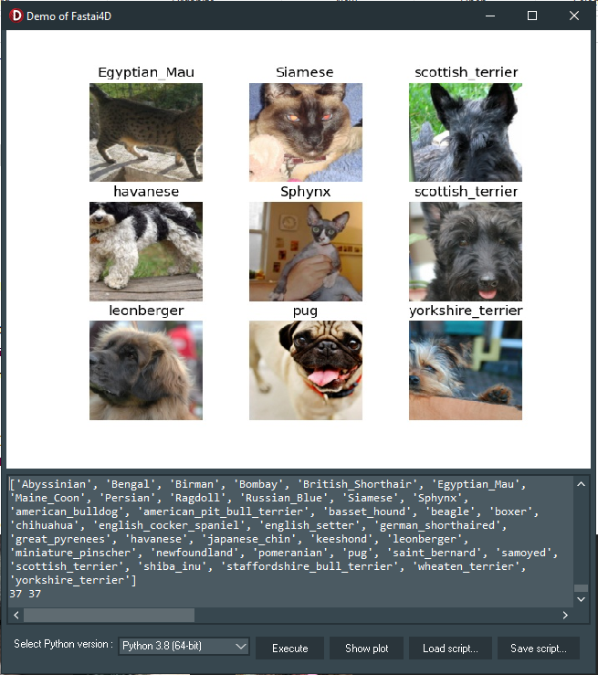
Demo
What Fastai4D Demo do?
Import the fastai library and run the basic example, by executing the “fastaiApp.py” on the backend
Load image datasets with their labels
We are going to use the Oxford-IIIT Pet Dataset by O. M. Parkhi et al., 2012 which features 12 cat breeds and 25 dog breeds.
Train deep learning model (ResNet-34)
Read more: https://blogs.embarcadero.com/how-to-make-a-state-of-the-art-deep-learning-app-with-fastai/

Slide 26
Demo
What is scikit-learn?
scikit-learn is an open-source Python machine learning library.
Simple and efficient tools for predictive data analysis
Built on top of SciPy, NumPy, and Matplotlib.
Classification, regression, and clustering
Among the algorithms available in scikit-learn:
Support vector machines
Random forests
Gradient boosting,
k-means
DBSCAN, etc.

Slide 27
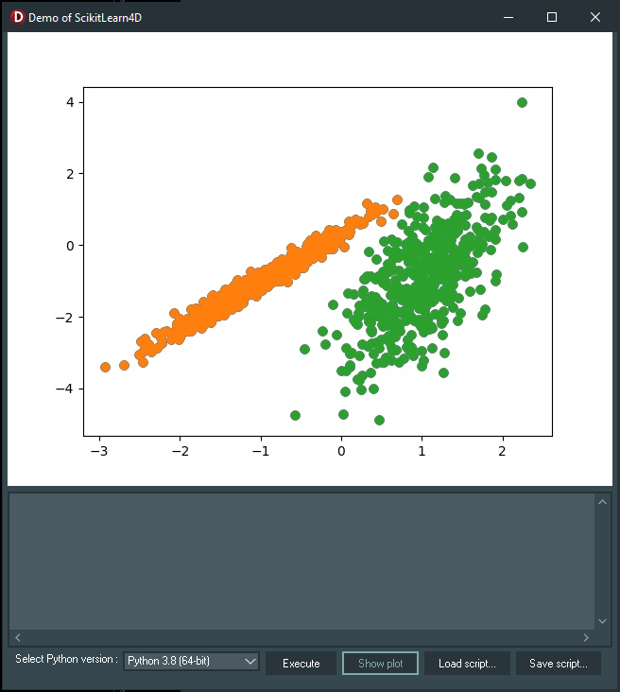
Demo
What ScikitLearn4D Demo do?
Import the scikit-learn library and run the basic example, by executing the “scikitlearnApp.py” on the backend
Perform 10 Unsupervised Machine Learning algorithms
Visualize 10 different plots.
Read more: https://blogs.embarcadero.com/10-unsupervised-machine-learning-algorithms-what-are-they-and-how-to-create-them/

Slide 28

Demo
What is NetworkX?
NetworkX is a Python package for creating, manipulating, and studying complex networks’ structure, dynamics, and functions.
NetworkX provides:
tools for studying the structure and dynamics of social, biological, and infrastructure networks;
a standard programming interface and graph implementation suitable for a wide range of applications;
a rapid development environment for collaborative, multidisciplinary projects;
an interface to existing numerical algorithms and code written in C, C++, and FORTRAN; and
the ability to work with large nonstandard data sets without difficulty.

Slide 29
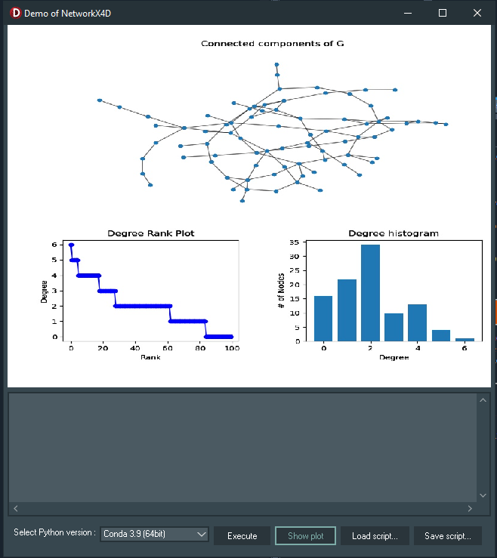
Demo
What NetworkX4D Demo do?
Import the networkx library and run the basic example, by executing the “networkxApp.py” on the backend
Plotting graphs and networks
Perform and plotting degree analysis
Read more: https://blogs.embarcadero.com/what-is-the-best-graphs-and-network-visualization-tool-on-windows/

Slide 30
Demo
What Next?
Save/record all the text output, instead of only printing it on TMemo
Add TStringGrid to present the structured data
Call the datasets directly from database
Show multiple image outputs
Your suggestions!

Slide 31

Demo 03: Pandas4D

Slide 32

Demo
What is pandas?
pandas is a Python package that provides fast, flexible, and expressive data structures designed to work with structured (tabular, multidimensional, potentially heterogeneous) and time-series data easily and intuitively.
pandas aim to be the fundamental high-level building block for doing practical, real-world data analysis in Python.

Slide 33
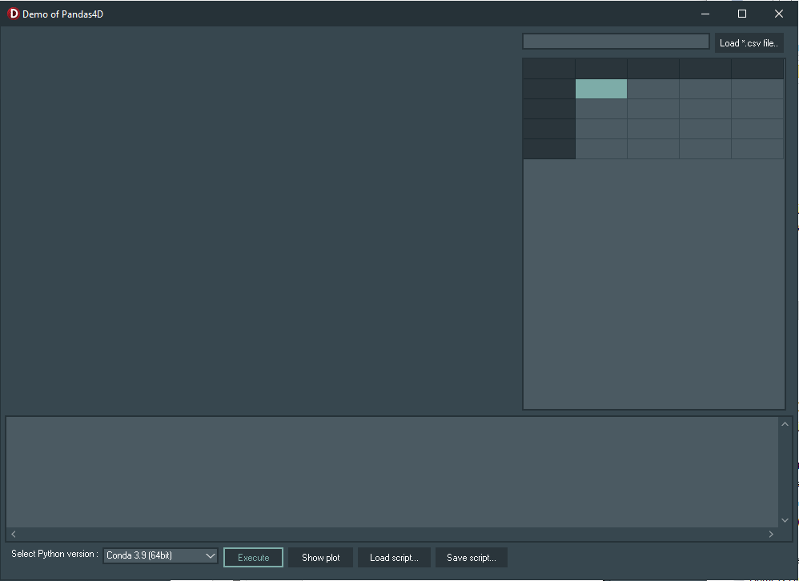
Demo
List of components used in the Pandas4D demo app:
1. TPythonEngine
2. TPythonModule
3. TPythonType
4. TPythonVersions
5. TPythonGUIInputOutput
6. TForm
7. TMemo
8. TOpenDialog
9. TSaveDialog
10. TSplitter
11. TImage
12. Tpanel
13. TLabel
14. TComboBox
15. TButton
16. TEdit
17. TStringGrid

Slide 34
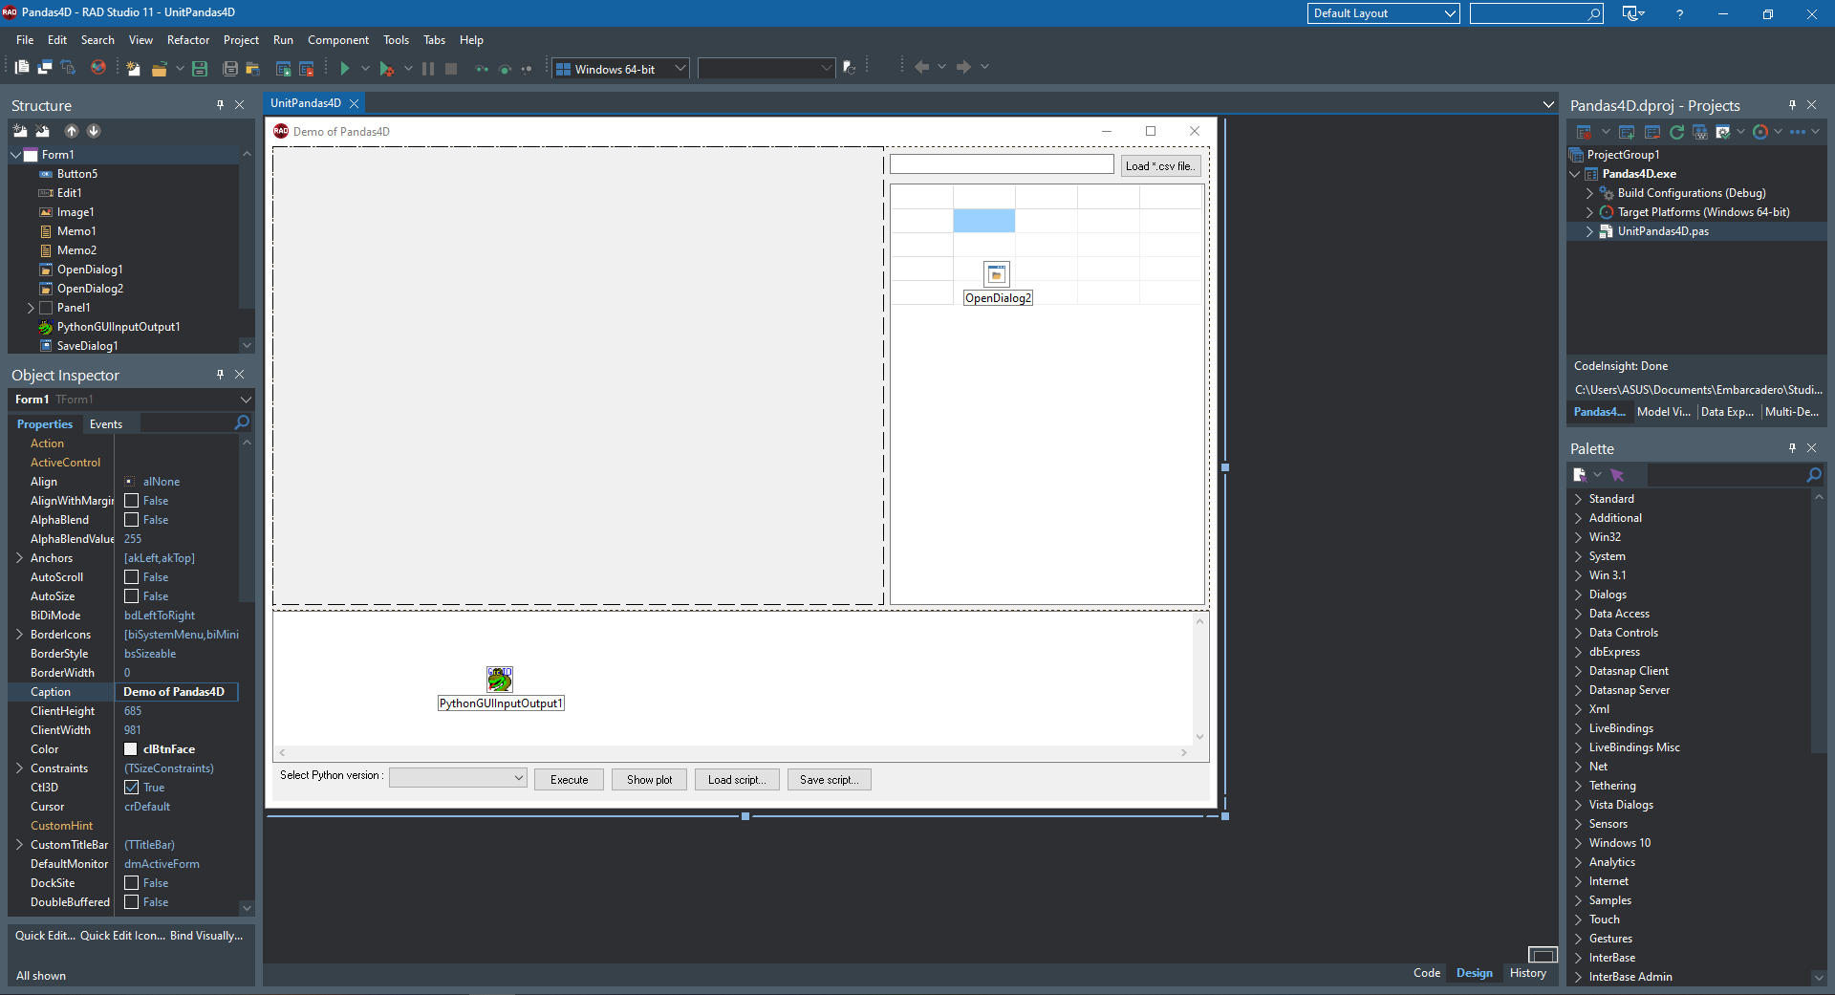
Demo

Slide 35
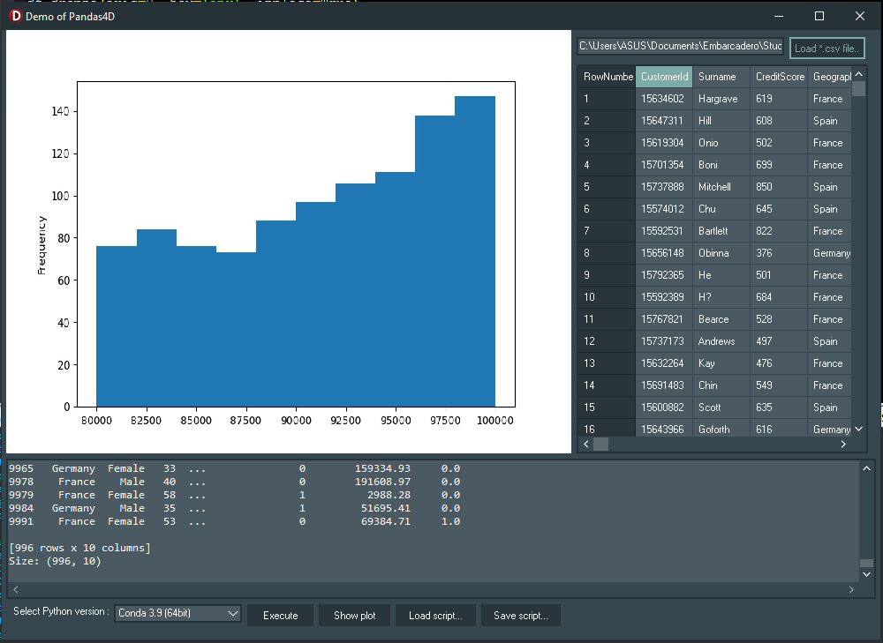
Demo
What Pandas4D Demo do?
Import the pandas library and run the basic example, by executing the “pandasApp.py” on the backend
Show the dataset on TStringGrid
Perform 17 data analysis steps
Produce 2 plots:
Histogram
Scatterplot matrix
For the article, stay tune on: https://blogs.embarcadero.com/author/hmazizul/

Slide 36
Demo
What Next?
Save/record all the text output, instead of only printing it on TMemo
Create more dynamic tables using TStringGrid to present the output, instead of TMemo
Call the datasets directly from database
Show multiple image outputs
Your suggestions!

Slide 37
Further Readings
What Is The Best Web Scraping Library For Development On Windows? https://blogs.embarcadero.com/what-is-the-best-web-scraping-library-for-development-on-windows/
How To Make Powerful Data Visualizations With Matplotlib https://blogs.embarcadero.com/how-to-make-powerful-data-visualizations-with-matplotlib/
How To Make A State-Of-The-Art Deep Learning App With Fastai https://blogs.embarcadero.com/how-to-make-a-state-of-the-art-deep-learning-app-with-fastai/

Slide 38
Further Readings
10 Unsupervised Machine Learning Algorithms: What Are They And How To Create Them https://blogs.embarcadero.com/10-unsupervised-machine-learning-algorithms-what-are-they-and-how-to-create-them/
What Is The Best Graphs And Network Visualization Tool On Windows? https://blogs.embarcadero.com/what-is-the-best-graphs-and-network-visualization-tool-on-windows/
Powerful Data Analysis And Manipulation Using Pandas Library In A Delphi Windows App https://pythongui.org/powerful-data-analysis-and-manipulation-using-pandas-library-in-a-delphi-windows-app/

Slide 39
Further Readings
Learn To Work With Real-World Graphics Using The Python Matplotlib Library In A Delphi Windows App https://pythongui.org/learn-to-work-with-real-world-graphics-using-the-python-matplotlib-library-in-a-delphi-windows-app/
Build A Machine Learning Solutions With Scikit-Learn Library In A Delphi Windows App https://pythongui.org/build-a-machine-learning-solutions-with-scikit-learn-library-in-a-delphi-windows-app/
Draw Visually Stunning Networks In Your Python GUI App Using NetworkX Python Library https://pythongui.org/draw-visually-stunning-networks-in-your-python-gui-app-using-networkx-python-library/

Slide 40
Further Readings
Learn To Build A GUI For These 10 Ultimate Python AI Libraries https://pythongui.org/learn-to-build-a-gui-for-these-10-ultimate-python-ai-libraries/
Introduction to Python GUI Development with Delphi for Python - Part 1: Delphi VCL for Python https://www.youtube.com/watch?v=m0r80fxZWPI
PyTorch for Delphi with the Python Data Sciences Libraries - Webinar Replay https://www.youtube.com/watch?v=IJB-Hx_Gi1M&t=371s
Getting Started with Python4Delphi https://www.youtube.com/watch?v=hjY6lBgrHhM&t=10s
Python4Delphi Demos https://github.com/pyscripter/python4delphi/tree/master/Demos

Slide 41




Thank you!
Get the code:
github.com/Embarcadero/CodingBootCamp2022

